Slide 1
Computer simulation and modeling in railway applications
Name: Shouvik Banerjee Argha
ID:20301118

Slide 2
Table of Contents:
1.Introduction
2.Railway System
3.Simulation Models
4.General-purpose railway system simulator
5.Conclusions

Slide 3
1.Introduction
1.Railways are unique, tailored to specific factors like social needs, finances, and geography.
Electrified railway systems are complex, with various subsystems.
2.Assessing costs, specifying parameters, identifying hazards, and exploring improvements are essential.
3.Computer simulation is a flexible and cost-effective tool for these assessments.
4.A comprehensive railway system simulation addresses motion equations, control, signaling, and power supply.
5.Developing whole-system simulators is challenging due to diverse tasks.
6.Major railway system components need detailed modeling.
7.A versatile whole-system simulator exists for studying multi-train operations in various railway systems.

Slide 4
2.Railway system
An electrified railway system consists of interconnected sub-systems, including signaling, power supply, and traction drives, which directly affect train performance. These sub-systems vary in specifications to meet specific railway system requirements.

Slide 5
2.1 Signaling
1. Signaling in Railway Safety: Signaling systems ensure safe train movement and traffic regulation.
2. Two Principles:
Block Safety Signaling: Tracks are divided into fixed blocks. Trains enter only if the block is clear and they can stop in time.
Moving-Block Signaling: Virtual blocks are based on the speed and braking of the train behind, improving frequency.
3. Complex Implementation: Signaling varies due to line-specific factors like speed limits, capacity, mixed traffic, and weather conditions.
4. Unique Features: Different systems have unique adaptations, like the British Rail's overlap distance and Sweden's point-machine defrosters for cold weather.
In summary, signaling ensures railway safety through block-based and moving-block methods. Each system is tailored to specific line requirements and may include special features for protection and efficiency.

Slide 6
2.2 Power System
Unique Power Supply Requirements: Electrified railways have specific needs, including power transmission, harmonics control, load movement, and electromagnetic compatibility.
DC Power for Metro Systems: Shorter metro lines with lighter trains and lower speeds mainly use DC power. It's simpler and derived from AC through transformers and rectifiers.
AC Power Challenges: AC power faces challenges in long-distance transmission and electromagnetic compatibility. Catenary feeding systems with booster transformers aim to improve efficiency and reduce interference but add complexity with extra overhead conductors.

Slide 7
2.3 Traction equipment
1. Flexible Speed Control: Railway traction drives must accommodate a wide range of train speeds.
2.Traditional Use of DC Traction Motors: DC traction motors have been traditionally favored for their adaptable speed control capabilities, often using DC-DC chopper or AC rectifier drives.
3.Advantages of AC Induction Motors: AC induction motors offer advantages such as lower maintenance and overhaul costs, high maximum speeds, and inherent regenerative braking capacity.
4.Challenges in Controlling AC Induction Motors: AC induction motors require variable-voltage and variable-frequency input for speed control, which became feasible with the development of advanced high-rating thyristors a few decades ago.
5.Rise in Popularity of AC Traction Drives: The development of advanced thyristors has led to the growing popularity of AC traction drives in recent years.
6.Distinct Power Electronics Circuits: DC and AC traction drives operate on different principles and can be supplied with either DC or AC power, requiring different power electronics circuits for speed control.
7.Starting Analysis Point: To comprehensively model a drive system, the analysis should begin from the secondary side of the step-down transformer directly connected to the power electronics circuit's input.

Slide 8
3. Simulation models
3.1. Train movement
1.Train movement simulation is critical for accommodating signaling system constraints and traction drive characteristics.
2.Effective data structures are essential for representing track geometry and signaling systems accurately.
3.Historical fixed-block signaling used two-dimensional arrays for data storage but lacked versatility and efficiency.
4.Object-oriented modeling, using nodes and links, offers a flexible representation of railway networks and enables continuous communication modeling.
5.Two simulation approaches:
5.1.Time-based models evaluate train movement at regular intervals, suitable for detailed information but computationally intensive.
5.2.Event-based models use predefined events triggered by train interactions, reducing computational demands but facing challenges with asynchronous event processing and assumptions.

Slide 9
3.2. Traction power supply
Electrified railways are complex electrical circuits with substations as sources and trains as loads, requiring accurate voltage control for traction performance.
DC supply systems use overhead lines or rails with straightforward modeling, including V-R models for substations.
AC traction systems use utility supply with harmonic filtering and require meticulous modeling due to interference concerns.
Modeling involves factors like conductor properties, geometry, and impedance calculations for the unique rail shape.

Slide 10
3.3. Traction drives
Traction equipment models provide traction effort, current, and power data for train movement and power network calculations.
DC traction systems require voltage-sensitive drive models due to pantograph voltage fluctuations.
Two modeling approaches, detailed and simplified, are used, with the simplified method practical for initial engineering stages.
Models are represented by the V-R model, with voltage and resistance values varying with train speed and operation.
Look-up tables for voltage and resistance are created, facilitating integration with the electrical circuit and power system.

Slide 11
3.4. Power network solution
1. Electrified railway circuits are essential for voltage and current calculations in railway simulations.
2. V-R models simplify circuit structures and improve computational efficiency.
3. Two primary approaches for solving the power network are load flow calculation and the direct matrix method.
4. Load flow calculation offers a straightforward interface but lacks direct feedback on voltage variations for train movement calculations.
5. The direct matrix method formulates matrix equations using mesh or nodal analysis, providing programming advantages for complex networks.
6. Railway traction power networks typically have ladder-type sections with sparse matrices, making efficient matrix elimination methods crucial.
7. Techniques like LLT and Cholesky decomposition are suitable for positive definite matrices in railway network equations.
8. Equation ordering methods, both static and dynamic, play a significant role in efficient problem-solving.
9. The minimum degree algorithm is useful for larger networks but less efficient for smaller ones due to time-consuming symbolic factorization.

Slide 12
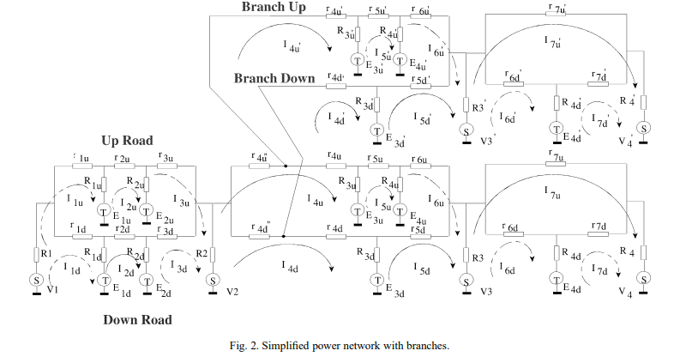

Slide 13
4. General-purpose railway system simulator
1. Existing railway simulators are typically designed for specific purposes or individual system components.
2. Railway research groups find it impractical to create multiple simulators for various studies.
3. There is a significant demand for a general-purpose multi-train simulator that can handle a wide range of research needs.
4. A multi-train simulator has been developed based on the described models.
5. This simulator is versatile and can be used for a variety of railway studies and applications.

Slide 14
4.1. Structure
1. The simulator comprises a library of software modules that model various aspects of railway subsystems.
2. Modules are selected from the library and combined to create a customized simulator for specific applications.
3. The simulator suite includes a graphical input interface, distinct categories of functions for different subsystems, and a shared data structure among these categories.
4. Modules within each category model functions of specific subsystems, accommodating various concepts and approaches for modeling flexibility.
5. Data is input through an interface, with options for dialogue boxes and graphical input, and data integrity checks are in place to prevent errors.
6. Databases are used to systematically store data for various purposes.
7. Function modules are developed independently, allowing for easy addition, deletion, or modification without affecting others.
8. The core of the simulator is a Simulator Manager, which selects the appropriate modules based on application specifications and manages initialization for the simulation.
9. Modules with similar functions but different approaches maintain the same protocol to ensure consistent interfaces with other function modules.
10. Modularity is a crucial feature that enhances the simulator's adaptability and versatility for diverse railway research needs.

Slide 15
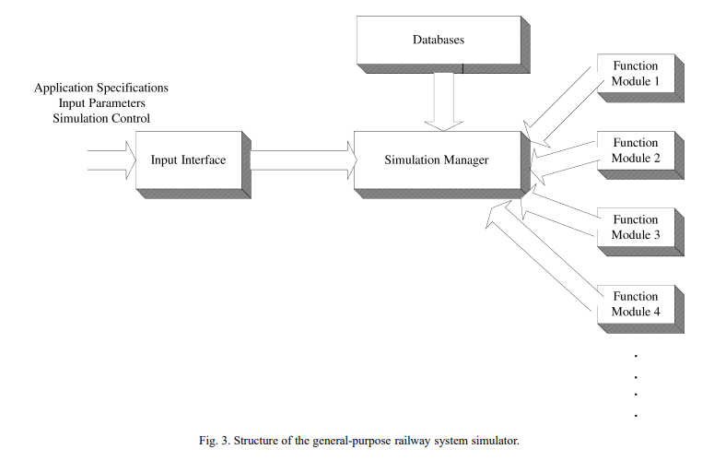

Slide 16
4.2 Progress and further Development
Simulator Development Milestones
Features in the Latest Version
Improved Input Interface
Output Presentation
AC Power Supply Network Implementation
Computational Complexity

Slide 17
4.3 Applications
Generic Nature of the Simulation Suite
Previous Applications
Future Expansion
Practical Tool for Railway Operators

Slide 18
5. Conclusion
Specialized Nature of Railway Systems
Review of Model Development Difficulties
Importance of Modeling
Caution in Model Development
General-Purpose Multi-Train Simulator

Slide 19
Thank you

